Slide 1

E-COMMERCE-RETAL-DATA-ANALYSIS

Slide 2
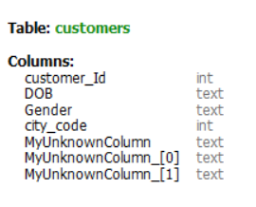

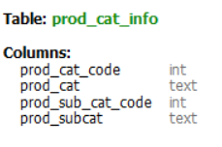
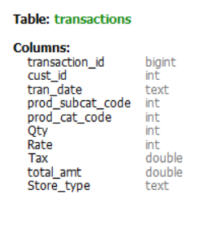
DATABASE SCHEMA
TABLES
Customers
2) Prod_cat_info
3) Transactions

Slide 3

--------------------------------------------OBJECTIVE--------------------------------------
1)To facilitate efficient management of e-commerce operations by maintaining comprehensive records of transactions, product catalog information, and customer data.
2) The integrated database system consists of three primary tables: Transaction, Prod_Cat_Info, and Customers. These tables collectively serve to streamline e-commerce operations, enhance customer experience, and enable data-driven decision-making
3) Transaction Table :This table supports various analytical tasks such as sales analysis, inventory management, and customer behavior analysis. Additionally, it ensures data integrity and consistency during financial reporting and auditing processes.
4) Prod_Cat_Info Table: This table supports inventory management, product recommendation systems, and enhances the user shopping experience by enabling effective categorization of products.
5) Customers Table: The Customers table maintains comprehensive records of customers and their relevant information. Each customer record includes attributes such as customer ID, name, contact details, and additional demographic or preference data.

Slide 4

DATA ANALYTICS Questions and their solutions are as.
.

Slide 5
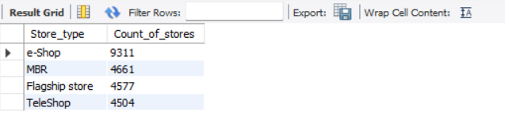
Q) Which channel is most frequently used for transactions?
RESULT
SOLUTION:
select Store_type, count(store_type) as Count_of_stores from P1.Transactionsgroup by store_type order by Count_of_stores desc;
Command used:
SELECT
COUNT
GROUP BY
ORDER BY

Slide 6
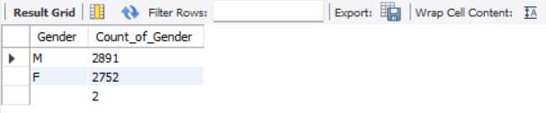
Q) What is the count of Male and Female customers in the database?
RESULT
SOLUTION:
SELECT Gender, COUNT(*) AS Count_of_Gender FROM Customers WHERE Gender IS NOT NULL GROUP BY Gender;
Command used:
SELECT
COUNT
GROUP BY

Slide 7
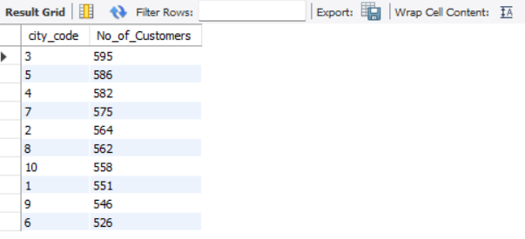
Q) From which city do we have the maximum number of customers and how many?
RESULT
SOLUTION:
SELECT city_code, COUNT(customer_id) AS No_of_Customers FROM Customers GROUP BY city_code ORDER BY no_of_customers DESC;
Command used:
SELECT
COUNT
GROUP BY
ORDER BY

Slide 8
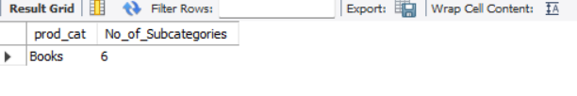
Q) How many sub-categories are there under the Books category?
RESULT
SOLUTION:
SELECT prod_cat, COUNT(prod_subcat) AS No_of_Subcategories FROM Prod_cat_info WHERE prod_cat = 'Books' GROUP BY prod_cat;
Command used:
SELECT
COUNT
GROUP BY
WHERE

Slide 9
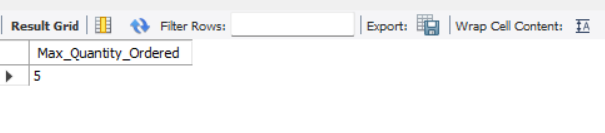
Q) What is the maximum quantity of products ever ordered?
RESULT
SOLUTION:
SELECT MAX(qty) AS Max_Quantity_Ordered FROM Transactions;
Command used:
SELECT
MAX QTY

Slide 10
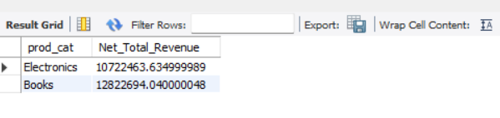
Q) hat is the net total revenue generated in categories Electronics and Books?
RESULT
SOLUTION:
SELECT prod_cat, SUM(total_amt) AS Net_Total_Revenue FROM Transactions trans INNER JOIN Prod_cat_info prod ON trans.prod_cat_code = prod.prod_cat_code AND trans.prod_subcat_code = prod.prod_sub_cat_code GROUP BY prod.prod_cat HAVING prod_cat IN ('Electronics', 'Books');
Command used:
SELECT , HAVING
COUNT, WHERE,SUM
INNER JOIN,AND
GROUP BY

Slide 11
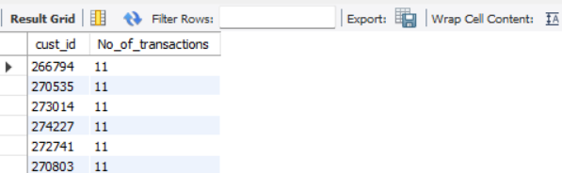
Q) How many customers have >10 transactions with us, excluding returns?
RESULT
SOLUTION:
SELECT cust_id, COUNT(transaction_id) AS No_of_transactions FROM Transactions WHERE total_amt > 0 GROUP BY cust_id HAVING COUNT(transaction_id) > 10;
Command used:
SELECT
COUNT
GROUP BY
WHERE

Slide 12

Q) What is the combined revenue earned from the "Electronics" & "Clothing"categories, from "Flagship stores"
RESULT
SOLUTION:
SELECT trans.Store_type, SUM(trans.total_amt) AS Combined_Revenue FROM Transactions trans INNER JOIN Prod_cat_info prod ON trans.prod_cat_code = prod.prod_cat_code AND trans.prod_subcat_code = prod.prod_sub_cat_code WHERE trans.total_amt > 0 AND prod_cat IN ('Electronics', 'Clothing' ) GROUP BY trans.Store_type HAVING trans.Store_type = 'Flagship store';
Command used:
SELECT , HAVING
COUNT, WHERE
INNER JOIN,SUM
GROUP BY,AND

Slide 13
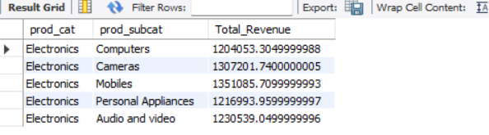
Q) What is the total revenue generated from "Male" customers in "Electronics"category? Output should display total revenue by prod sub-cat.
RESULT
SOLUTION:
SELECT prod.prod_cat, prod.prod_subcat, SUM(trans.total_amt) AS Total_Revenue FROM Transactions trans INNER JOIN Prod_cat_info prod ON trans.prod_cat_code = prod.prod_cat_code AND trans.prod_subcat_code = prod.prod_sub_cat_code INNER JOIN Customers cust ON trans.cust_id = cust.customer_Id WHERE trans.total_amt > 0 and cust.Gender = 'M' GROUP BY prod.prod_cat, prod.prod_subcat HAVING prod.prod_cat = 'Electronics' ;
Command used:
SELECT , HAVING
COUNT, WHERE
INNER JOIN
ORDER BY , GROUP BY

Slide 14
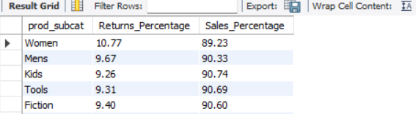
Q) What is percentage of sales and returns by product sub category; display only top 5 sub categories in terms of sales?
RESULT
SOLUTION:
SELECT prod.prod_subcat, SUM(trans.total_amt) AS Sales_Amount FROM Transactions trans INNER JOIN Prod_cat_info prod ON trans.prod_cat_code = prod.prod_cat_code AND trans.prod_subcat_code = prod.prod_sub_cat_code WHERE trans.total_amt > 0 GROUP BY prod.prod_subcat ORDER BY Sales_Amount; # --Percentage sales and returns WITH Sales_Returns AS ( SELECT prod.prod_subcat, SUM(CASE WHEN trans.Qty > 0 THEN trans.Qty ELSE 0 END) AS Sales_value, ABS(SUM(CASE WHEN trans.Qty < 0 THEN trans.Qty ELSE 0 END)) AS Returns_value FROM Transactions trans INNER JOIN Prod_cat_info prod ON trans.prod_cat_code = prod.prod_cat_code AND trans.prod_subcat_code = prod.prod_sub_cat_code GROUP BY prod.prod_subcat ORDER BY Sales_value DESC ) SELECT prod_subcat, ROUND(((Returns_value / (Returns_value + Sales_value))*100), 2) AS Returns_Percentage, ROUND(((Sales_value / (Returns_value + Sales_value))*100), 2) AS Sales_Percentage FROM Sales_Returns;
Command used:
SELECT , HAVING
COUNT, WHERE,SUM
INNER JOIN,AND
ORDER BY , GROUP BY

Slide 15
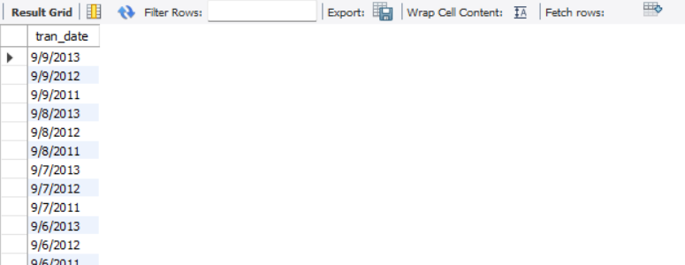
Q) For all customers aged between 25 to 35 years find what is the net total revenuegenerated by these consumers in last 30 days of transactions from max transactiondate available in the data?
RESULT
SOLUTION:
SELECT (tran_date) FROM Transactions GROUP BY tran_date ORDER BY tran_date DESC;
WITH ABC AS(SELECT (tran_date), SUM(total_amt) AS Total_amount FROM Customer c INNER JOIN Transactions t ON t.cust_id = c.customer_id
WHERE DATEDIFF(YEAR,DOB,GETDATE()) BETWEEN 25 AND 35 GROUP BY tran_date ORDER BY tran_date DESC)
SELECT SUM(Total_amount) AS Final_revenue FROM ABC;
Command used:
SELECT
SUM
INNER JOIN
ORDER BY , GROUP BY

Slide 16
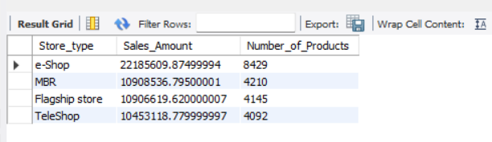
Q) Which store-type sells the maximum products; by value of sales amount and by quantity sold?
RESULT
SOLUTION:
SELECT Store_type, SUM(total_amt) AS Sales_Amount, COUNT(Qty) AS Number_of_Products FROM Transactions WHERE total_amt > 0 GROUP BY Store_type ORDER BY Sales_Amount DESC, Number_of_Products DESC;
Command used:
SELECT ,COUNT
SUM
INNER JOIN
ORDER BY , GROUP BY

Slide 17
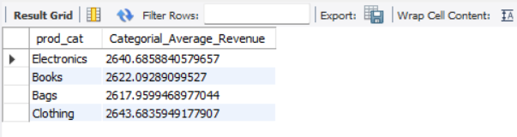
Q) What are the categories for which average revenue is above the overall average,
RESULT
SOLUTION:
SELECT prod.prod_cat, AVG(trans.total_amt) AS Categorial_Average_Revenue FROM Transactions trans INNER JOIN Prod_cat_info prod ON trans.prod_cat_code = prod.prod_cat_code AND trans.prod_subcat_code = prod.prod_sub_cat_code WHERE trans.total_amt > 0 GROUP BY prod.prod_cat HAVING AVG(trans.total_amt) > (SELECT AVG(total_amt) AS Overall_Average_Revenue FROM Transactions WHERE total_amt > 0);
Command used:
SELECT , HAVING
COUNT, WHERE,SUM
INNER JOIN,AVG
ORDER BY , GROUP BY

Slide 18
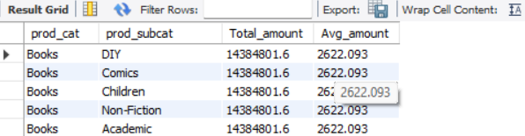
Q) Find the average and total revenue by each subcategory for the categories whichare among top 5 categories in terms of quantity sold
RESULT
SOLUTION:
SELECT prod.prod_cat, AVG(trans.total_amt) AS Categorial_Average_Revenue FROM Transactions trans INNER JOIN Prod_cat_info prod ON trans.prod_cat_code = prod.prod_cat_code AND trans.prod_subcat_code = prod.prod_sub_cat_code WHERE trans.total_amt > 0 GROUP BY prod.prod_cat HAVING AVG(trans.total_amt) > (SELECT AVG(total_amt) AS Overall_Average_Revenue FROM Transactions WHERE total_amt > 0);
Command used:
SELECT , HAVING
COUNT, WHERE
INNER JOIN,AVG
AND, GROUP BY

Slide 19




Thank You
YASH GHANWATE
702849643
YASHGHANWATE2@GMAIL.COM

